Slide 1
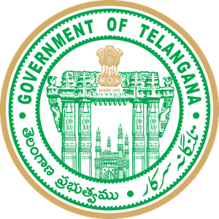
Telangana Growth Analysis
Stamp Registration, Transportation and Ts-Ipass
Vijay Jose W

Slide 2
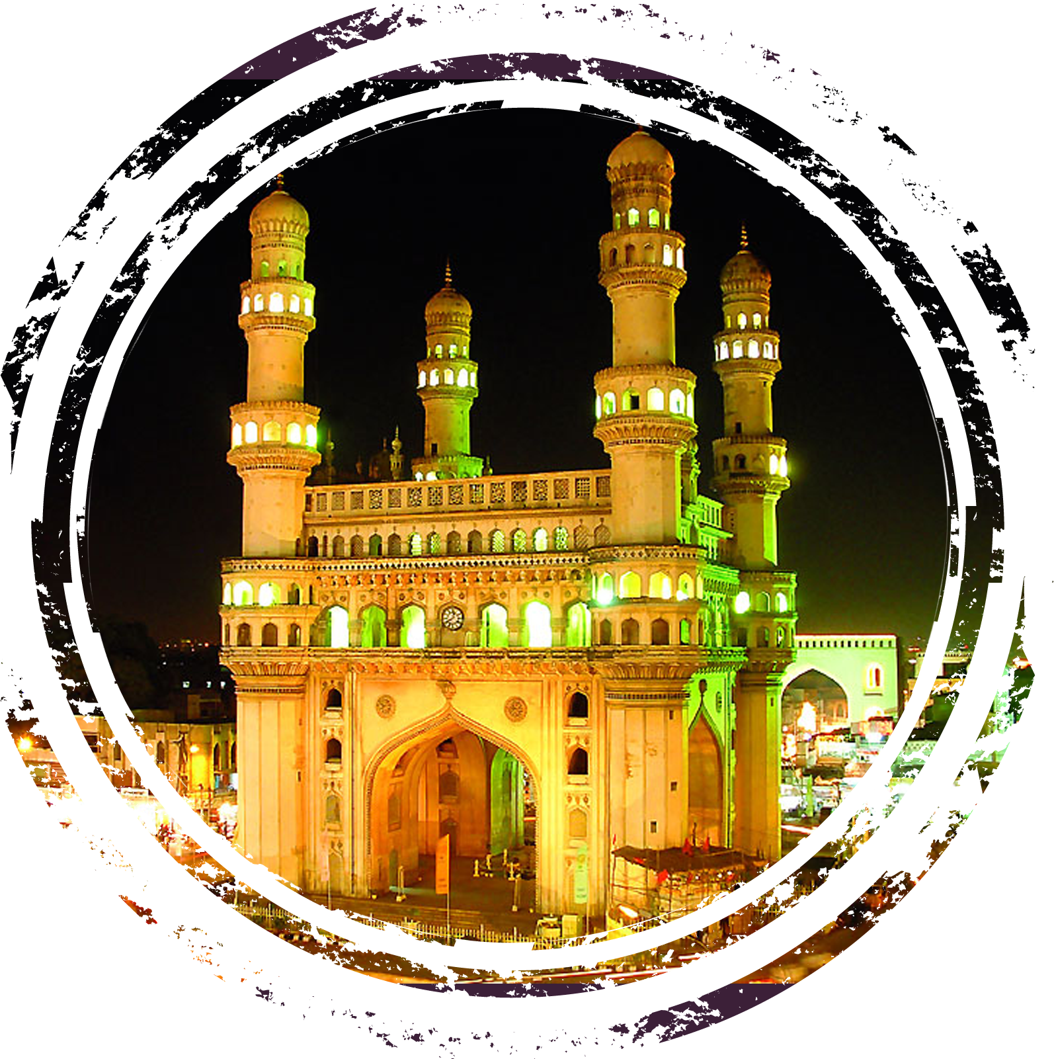
Title of the Topics
Preface
Objectives
Stamp Registration
Transportation
Ts-Ipass
Secondary research

Slide 3


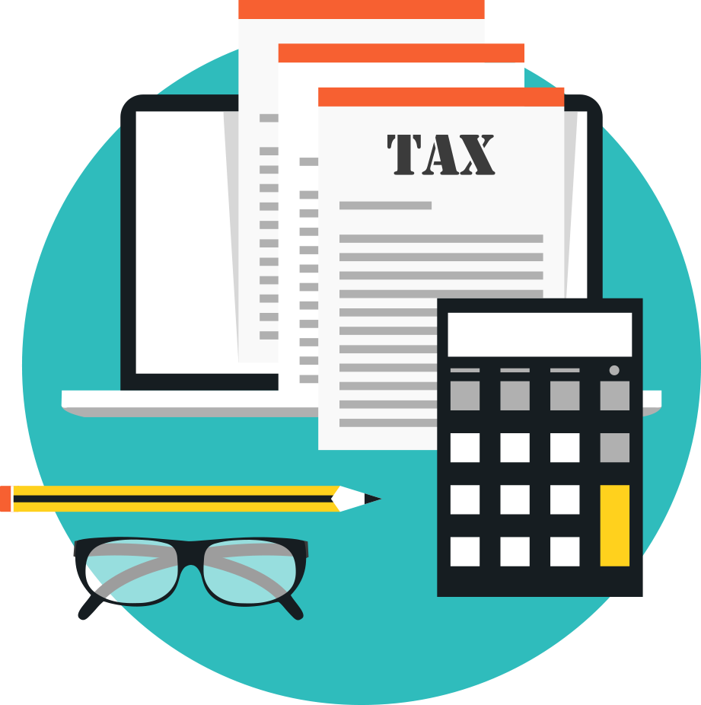
Preface
Telangana is one of the 28 states in India, located in the southern part of the country. It was officially formed as a separate state on June 2, 2014, In recent years, Telangana has been on a path of rapid economic growth and development, particularly in sectors such as information technology, pharmaceuticals, and manufacturing. The state government has implemented several initiatives to promote industrialization and infrastructure development, making Telangana an important contributor to India's economic growth
As per the Provisional Advance Estimates for 2022-23, Telangana's Gross State Domestic Product (GSDP) at current prices is Rs. 13.27 lakh crore – a growth of 15.6% over the 2021- 22 value, as against the country's GDP growth rate of 15.4%.
Interdiction: With an intention to give boost to economic growth, the government has enacted the special economic zone (SEZ) Act, 2005, whereby various fiscal incentives have been introduced for entrepreneurs and developers.
According to the 2011 census, Hindus form 85.1% of the State's population. Muslims form 12.7% and Christians form 1.3%.

Slide 4
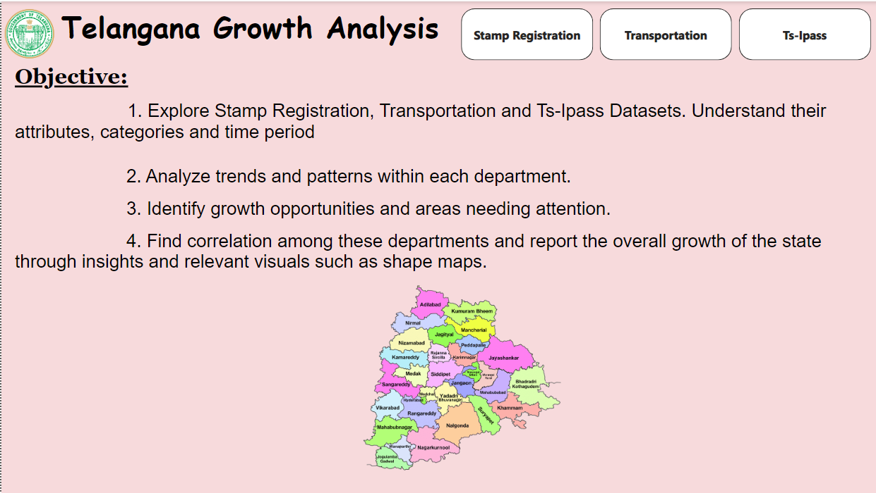
Introduction
Visual Insight Home Page

Slide 5
Stamp Registration
Stamp registration in Telangana, as in many other Indian states, is governed by the Indian Stamp Act, 1899. The primary purpose of stamp registration is to ensure the legality, authenticity, and enforceability of various documents, including property transactions, agreements, and other legal instruments. The Stamp and Registration Department of Telangana is responsible for administering stamp duties and registration processes in the state.
Revenue Generation: Stamp registration involves the collection of taxes on various transactions, including property sales and leases.
Property Market Development: Proper stamp registration helps regulate the property market by ensuring transparency and legal compliance in real estate transactions.
Legal Security: It provides legal validation and security to property owners, which in turn boosts investor confidence and encourages property-related economic activities.

Slide 6
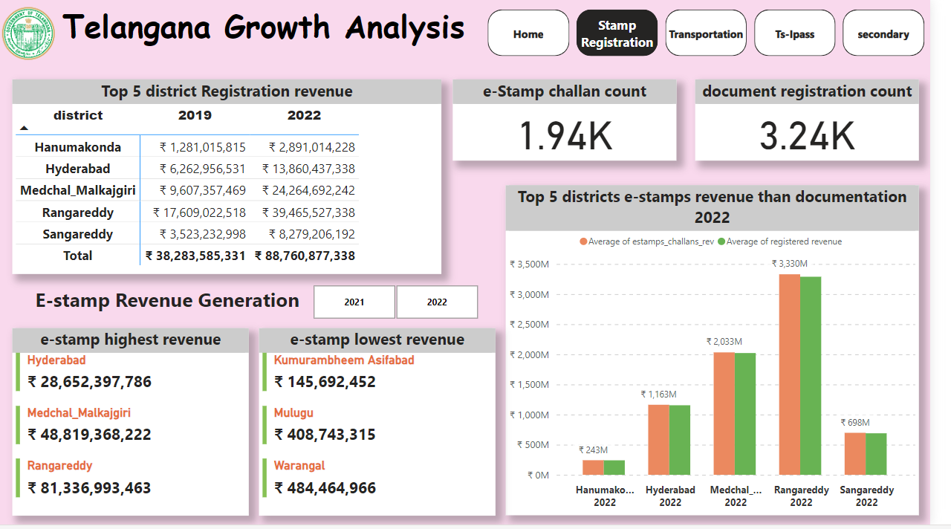
Stamp Registration

Slide 7
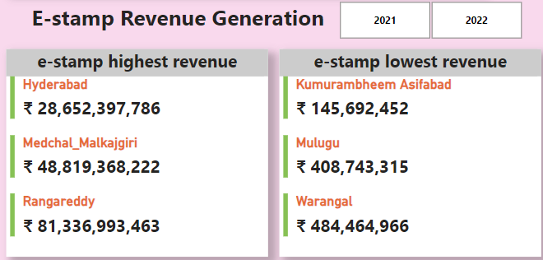
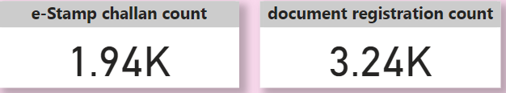
Top 5 District Compared With Highest and Lowest Revenue E-Stamp in Year 2021-2022
Telangana recorded stamp duty and collection charge collections of Rs 70 billion in eight months of FY 2022 (April-November) against Rs 52 billion during FY 2021. This also translated into an overall collection increase from 4 per cent in FY 2021 to 7 per cent in FY 2022.

Slide 8
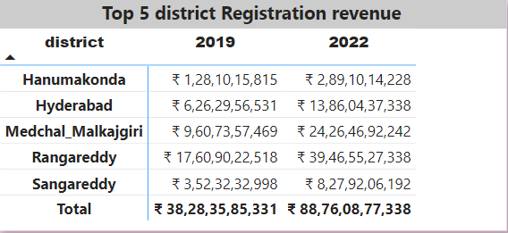
Revenue generated from document registration vary across districts in Telangana. and its Top 5 Districts
stamps duty and registration fees, and state excise duty are estimated to increase at an annual rate of 37% and 19% over 2019-20, respectively.and 108% change from 2020-21 RE to 2021-22 BE

Slide 9
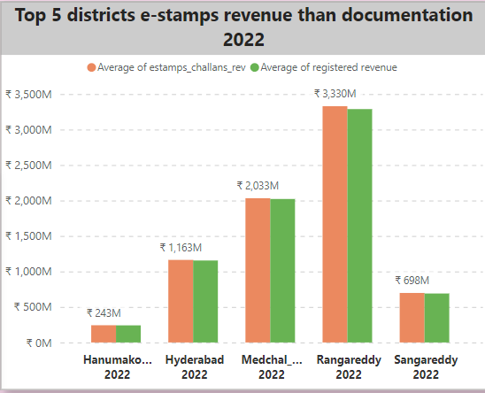
Top 5 districts where e-stamps revenue contributes significantly more to the revenue than the documents in FY 2022
The revision of market values of the lands and revision of stamp duty rates in 2021-22 (July-December) led to doubling of monthly revenue of stamps and registrations in comparison to the monthly revenue during the corresponding time period in 2019-20.

Slide 10
Transportation
Telangana has an extensive road network that includes national highways, state highways, and district roads.Several national highways, including NH-44 (previously NH-7), NH-65, and NH-163, pass through Telangana, Overall, out of the 1.51 crore vehicles, a total of 1.11 crore are two-wheelers, 19.45 lakh are cars, 6.8 lakh are tractors and trailers, 5.9 lakh are goods carriages and 4.48 lakh are auto rickshaws. In Hyderabad, there are more than 77 lakh vehicles out of which over 57 lakh are two-wheelers and 13.76 lakh are cars.
Connectivity: Efficient transportation networks, including roads, railways, and airports, connect different regions, facilitating the movement of goods and people.
Supply Chain Efficiency; An effective transportation system reduces logistics costs, which is critical for the competitiveness of businesses. It enables timely and cost-effective movement of raw materials and finished products.
Job Creation:The development of transportation infrastructure creates jobs directly in construction and maintenance and indirectly by enabling economic activities in areas served by these networks.

Slide 11
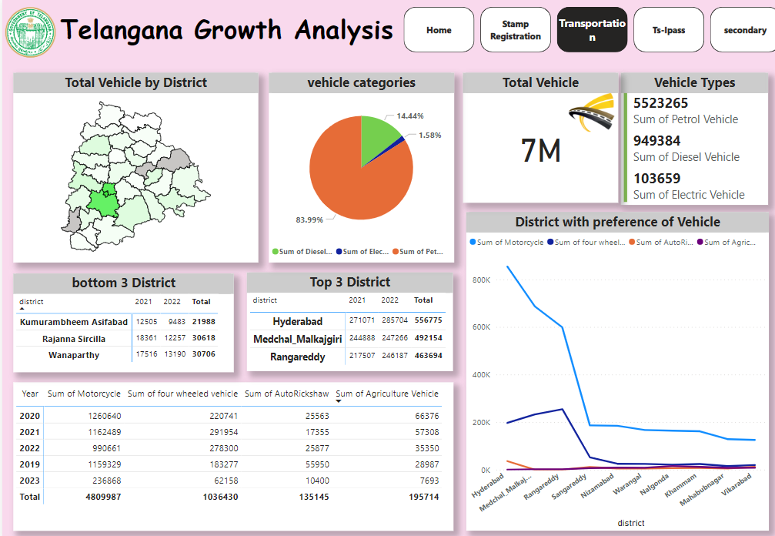
Transportation

Slide 12
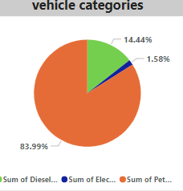
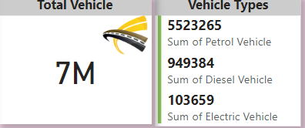
Are there any months or seasons that consistently show higher or lower sales rate, and if yes, what could be the driving factors?
Yes there is a higher purchase of vehicles during the month of march and October. This could be the tax reporting month for the new Year is April and generally monsson starts on October

Slide 13
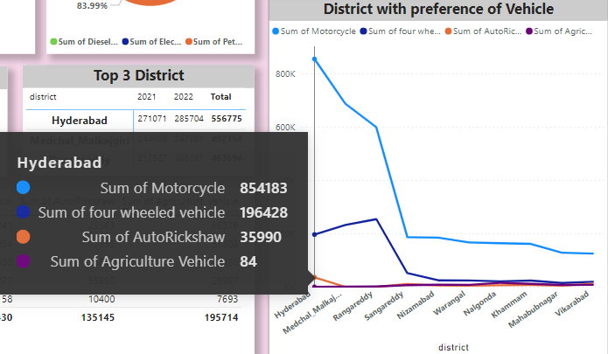
Are there any districts with a predominant preference for a specific vehicle class?
The number of people using motorcycles and motor cars are higher in the districts of Rangareddy, Medchal Malkajgiri and hyderabad as compared to the others. In hyderabad alone the count of motor cycles for the Year 2022 have crossed 2 lakhs.

Slide 14
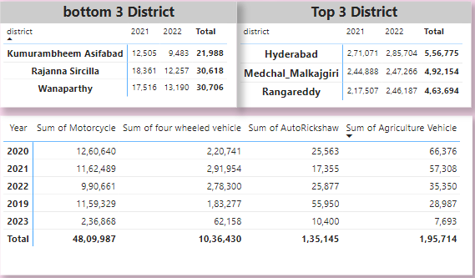
List down the top 3 and bottom 3 districts that have shown the highest and lowest vehicle sales growth during FY 2022
In District Kumurambheem Asifabad is the lowest Vehicle Sale compare to Year 2021 and 2022 and There is Increase in Vehicle sale in Year 2022

Slide 15
Ts-ipass
(Telangana State Industrial Project Approval and Self-Certification System)
Telangana State Industrial Project Approval and Self-Certification System (TS-iPass) was statutorily enacted in 2014 The Act. The central purpose of the act is to mandate industrial clearances within a pre-established time span, including penalties if clearance applications are not processed within said time span. Telangana through its flagship initiative of TS-iPASS has attracted 22,745 industries so far, investments of Rs. 2,60,060 Crs. and created employment for 17.54 lakhs people.
Ease of Doing Business: TS-iPASS simplifies and expedites the approval process for setting up industries in Telangana. This ease of doing business attracts both domestic and foreign investments
Industrial Expansion: By reducing bureaucratic hurdles and promoting self-certification, TS-iPASS encourages existing industries to expand their operations, contributing to increased production and employment.finished products.
Economic Diversification: TS-iPASS encourages diversification into various sectors, promoting a balanced and resilient economy beyond traditional industries.

Slide 16
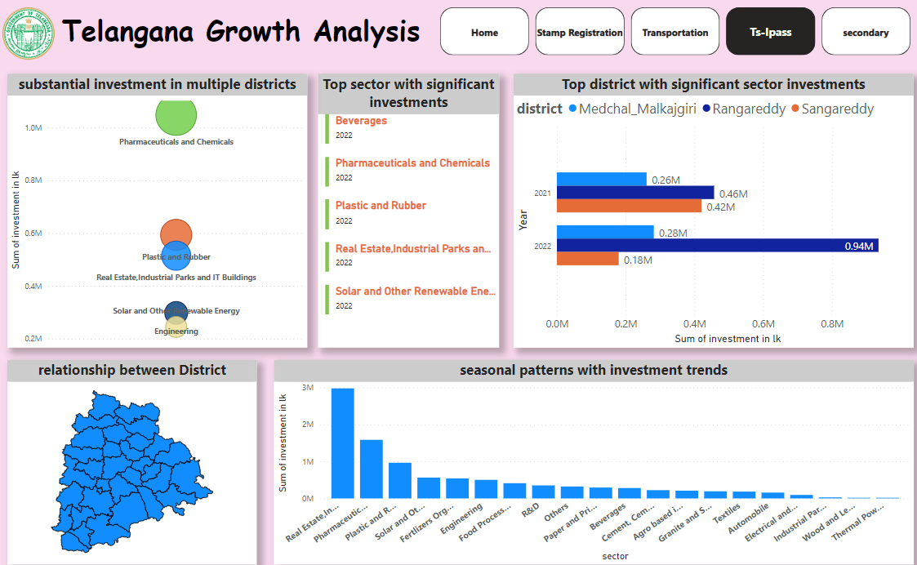
Telangana State Industrial Project Approval and Self-Certification System Ts-ipass

Slide 17
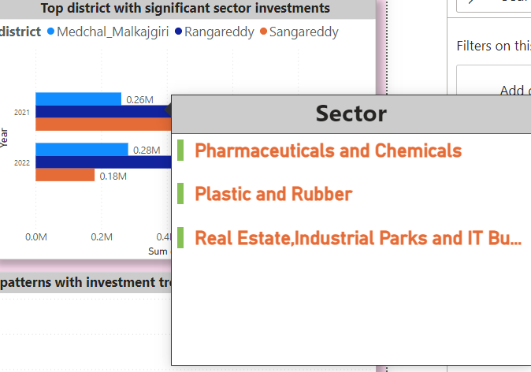
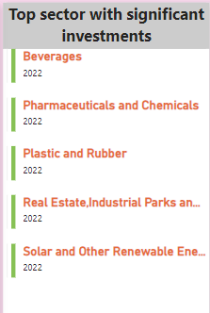
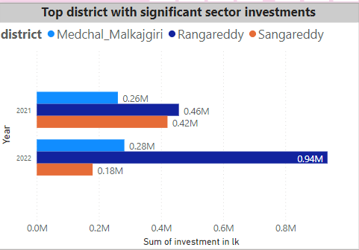
List down the top 5 sectors that have witnessed the most significant investments in FY 2022.
Beverages, Plastic and Rubber, Pharmaceuticals and Chemicals, Real Estate,Industrial Parks and IT Buildings, Solar and Other Renewable Energy, Engineering have witnessed the most significant investments Year 2022.
List down the top 3 districts that have attracted the most significant
sector investments during FY 2019 to 2022?
Rangareddy, Sangareddy and Medchal Malkajgiri have the most significant sector investments during Year 2019 to 2022. all the districts have a high correlation of sales of vehicles and stamps revenue to their total investments.

Slide 18
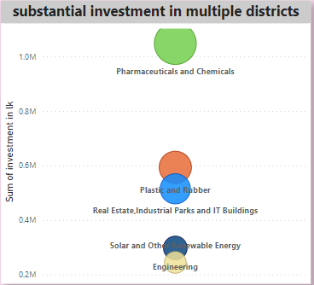
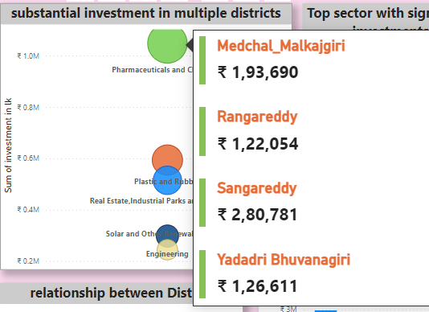
Are there any particular sectors that have shown substantial investment in multiple districts between FY 2021 and 20222?
Pharmaceuticals and Chemicals, and Plastic and Rubber sector show a substantial investment in multiple districts between Year 2021 and 2022

Slide 19
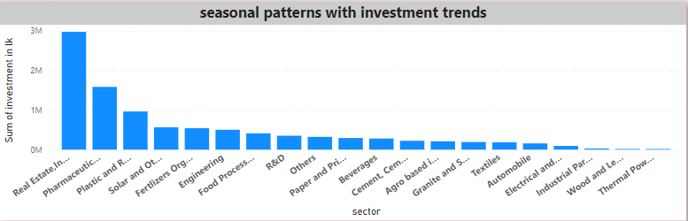
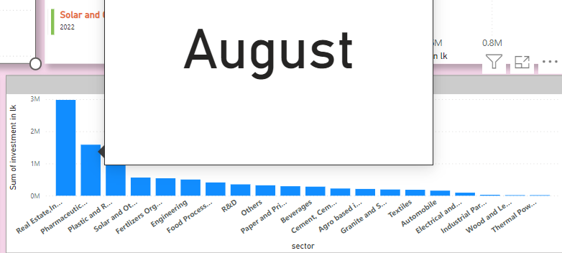
Can we identify any seasonal patterns or cyclicality in the investment trends for specific sectors?
Most of Investment is between April and August Fiscal Quarter 2 & 3. The Sector Like Real Estate,Industrial Parks and IT Buildings, Plastic and Rubber, Pharmaceuticals and Chemicals experience higher investments during particular months

Slide 20
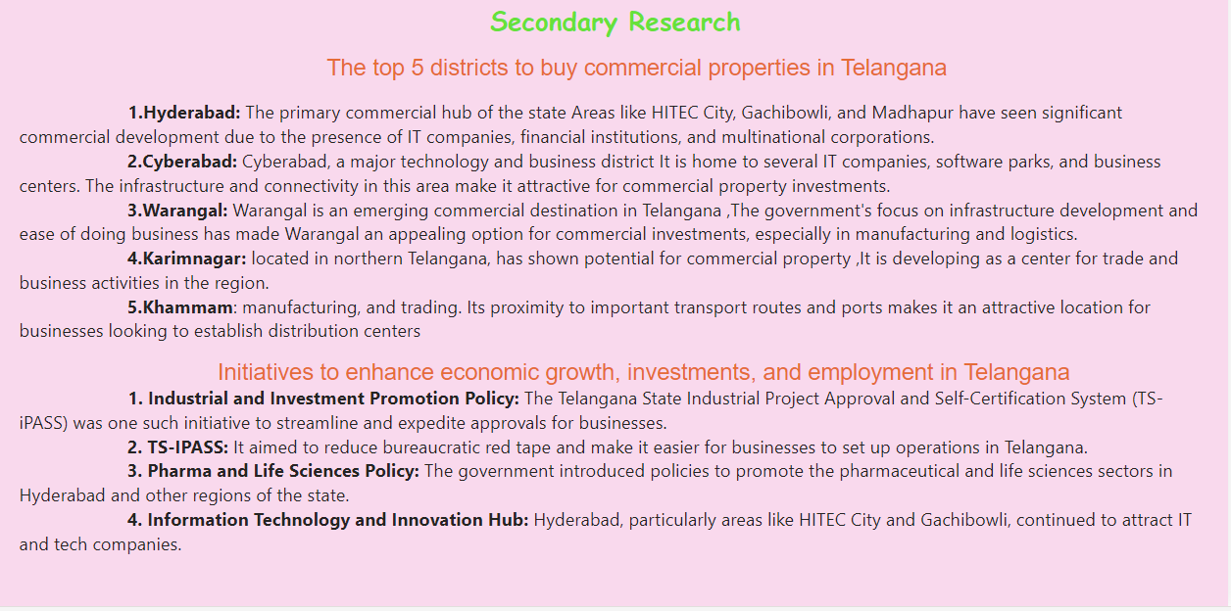
Secondary Research

Slide 21

Thank You

